Slide 1
Coastal Fire Centre
FMLT Port McNeill, May 4, 2016
2015 Fire Season Review
2016 Fire Season Outlook
Pete Laing, RFT
Acting Fuels Management Specialist
Notes:
Think of your audience and remove any slide that will not fit.

Slide 2
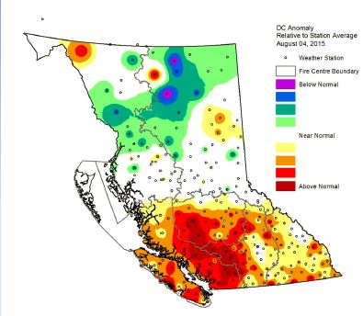
2015 Weather
Warm & dry spring
transitioned into
above average
hot & dry
Summer
= VERY HIGH DC
Notes:
Coastal Drought Codes in August were some of the highest in province

Slide 3
2015 Coastal Fire Starts
Slightly lower than 10 year average,
but there were 8 very large significant fires
Fires | 2015 | 10 year average
Total | 193 | 225
Person caused | 136 | 149
Lightning caused | 57 | 77
Notes:
Current BWS vernacular Human Caused (not person) Natural Cause (included Lightning)

Slide 4
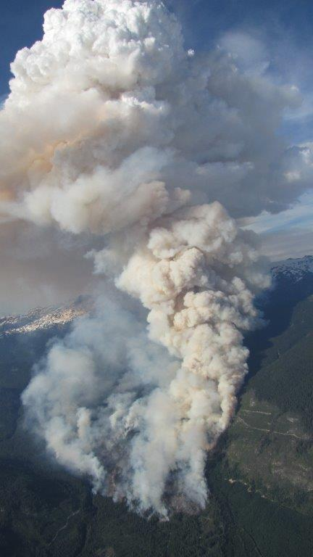
Large Coastal Fires
Elaho 67 k V30160
~ 67 km west of Pemberton
Type | Modified Response
Size | 13,052 ha | Cause | Lightning
Start | June 14 | As at Nov: Patrol
Popular recreational area FS road closed periodically Elaho Giant tree Brutally steep & inaccessible terrain Geologically unstable area prone to slides: hazards to crews

Slide 5
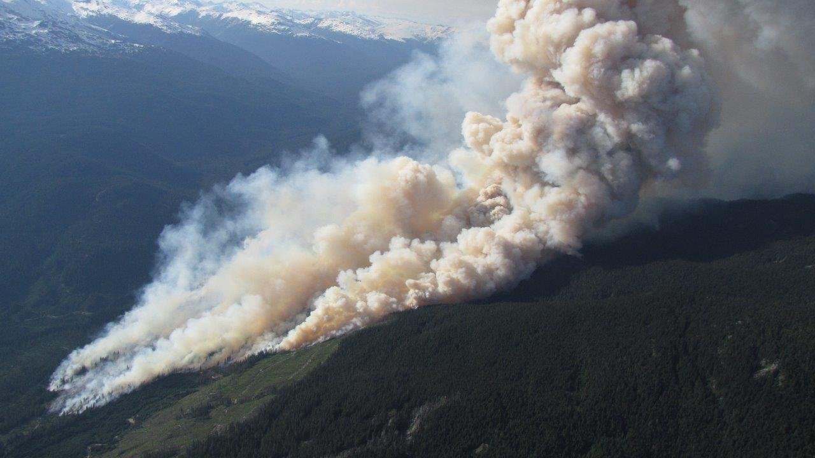
V30160 – June 15, 2015

Slide 6
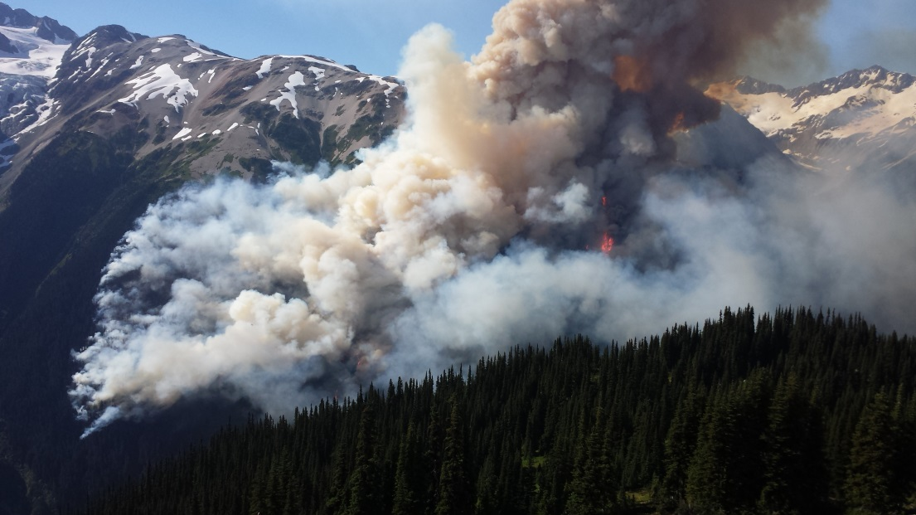
Large Coastal Fires
Boulder Creek, V30241
~23 km northwest of Pemberton Meadows
Type | Modified Response
Size | 6,735 ha | Cause | lightning
Discovery | Jun 30 | As at Nov: Patrol
Evacuation of Hydro project Ares restrictions, FS Road closures Geologically unstable area prone to slides presented hazards to crews

Slide 7
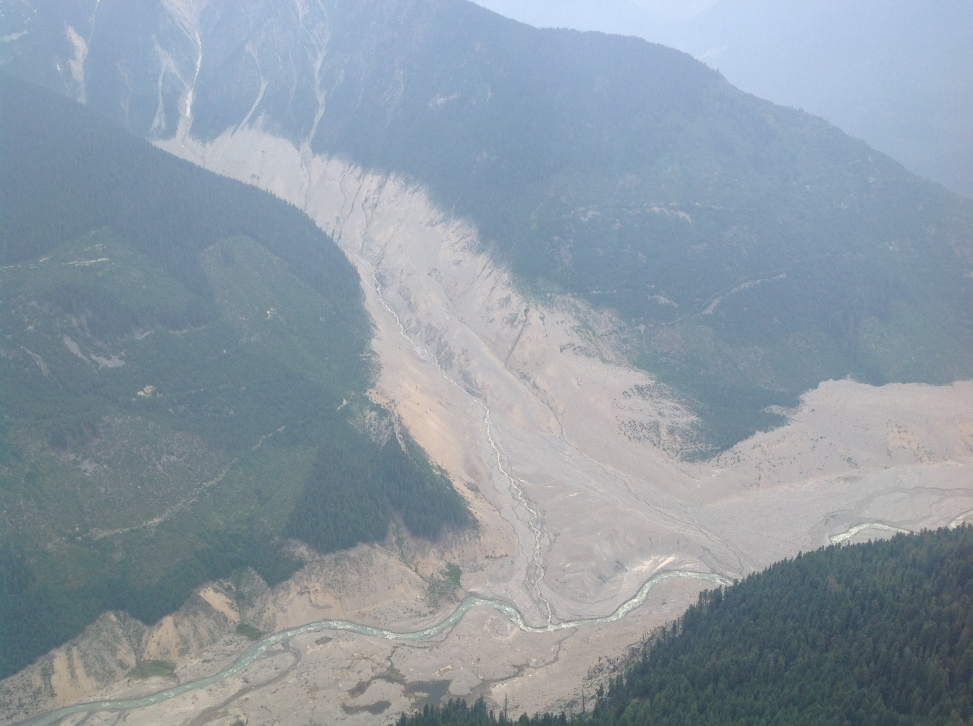
V30241 – Meager Creek landslide

Slide 8
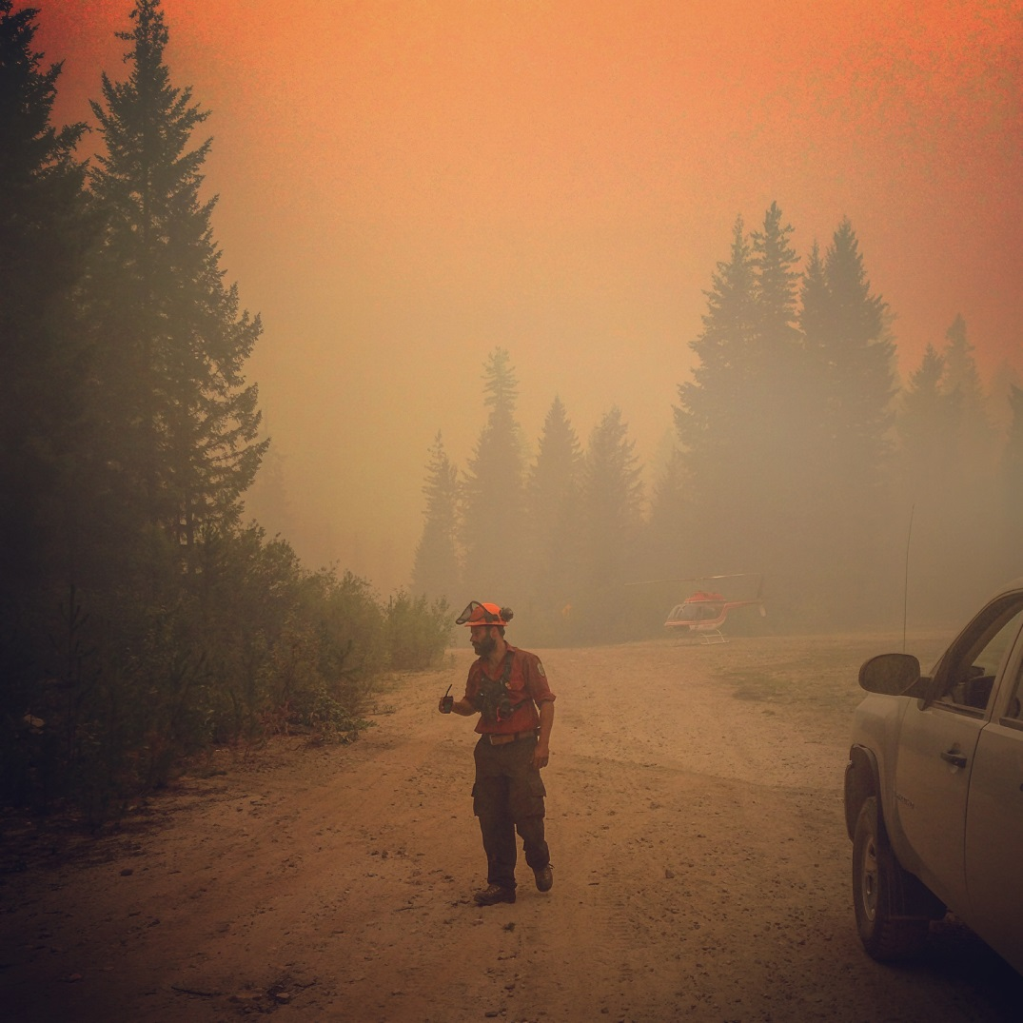
Large Coastal Fires
Cougar Creek, V10247
Fraser Canyon area, south of Nahatlach River
Type | Modified Response
Size | 2,985 ha | Cause | Lightning
Discovery | Jul 1 | As at Nov: Modified Response
Area restrictions, FS Road closures, evacuation alerts Periodically produced heavy smoke, impacting lower mainland

Slide 9
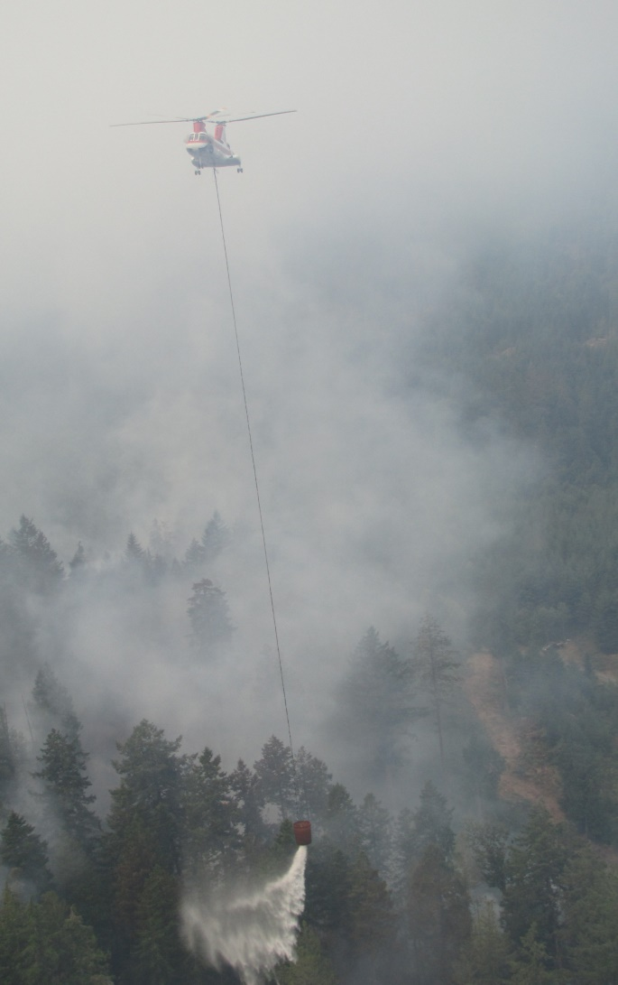
Large Coastal Fires
Old Sechelt Mine, V50256
~ 2 km Northwest of Sechelt
Type | Modified Response
Size | 423 ha | Cause | human
Start | July 2 | As at Nov: Patrol
Evacuation orders & alerts Area restrictions & FS Road closures Fatality Controlled burning used to contain fire within existing road systems

Slide 10
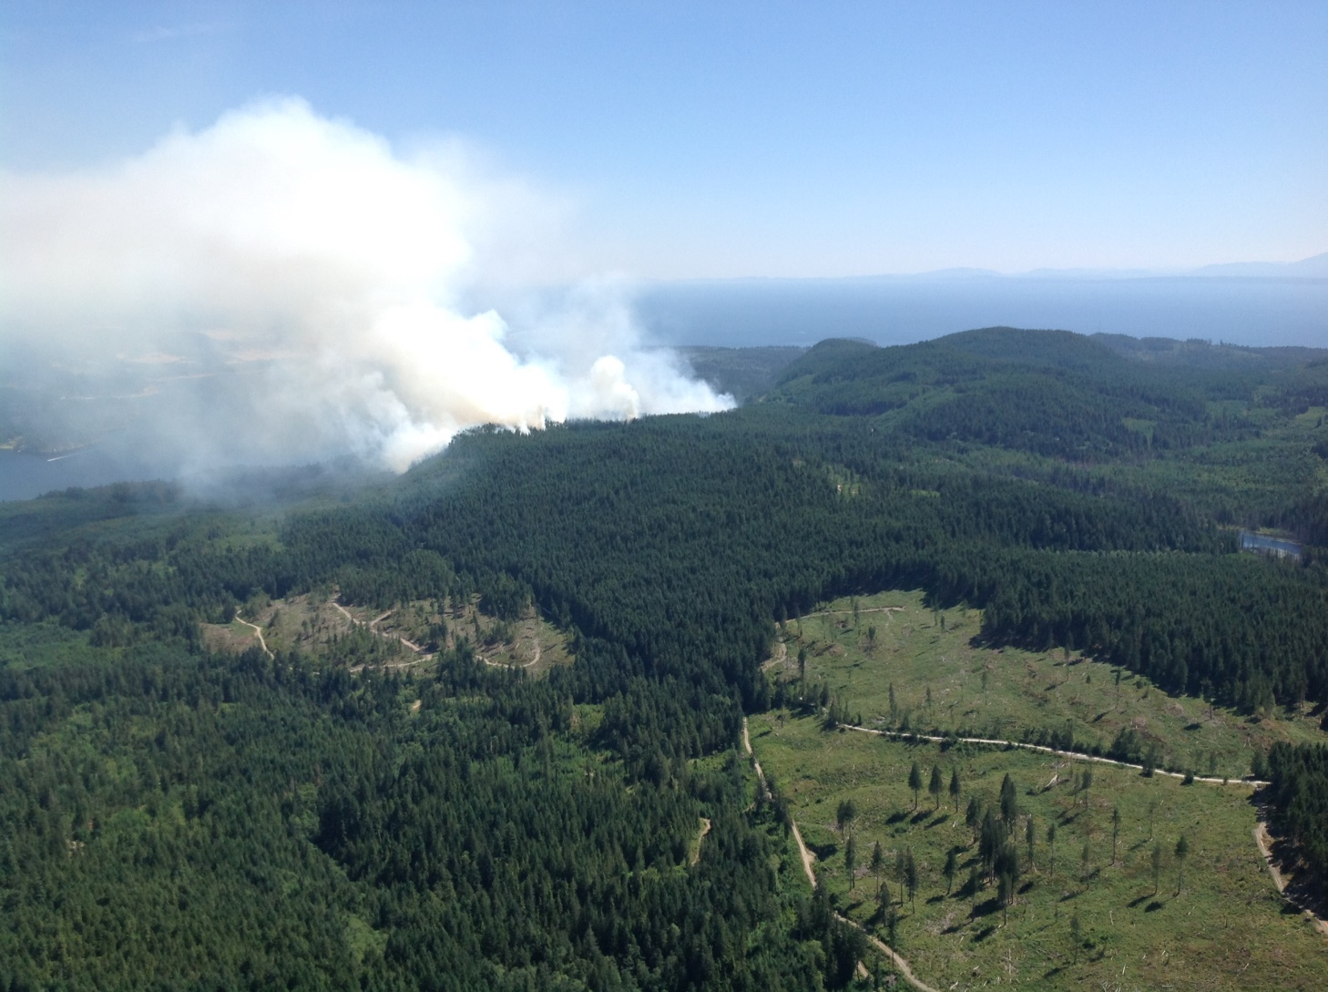
July 4, 2016

Slide 11
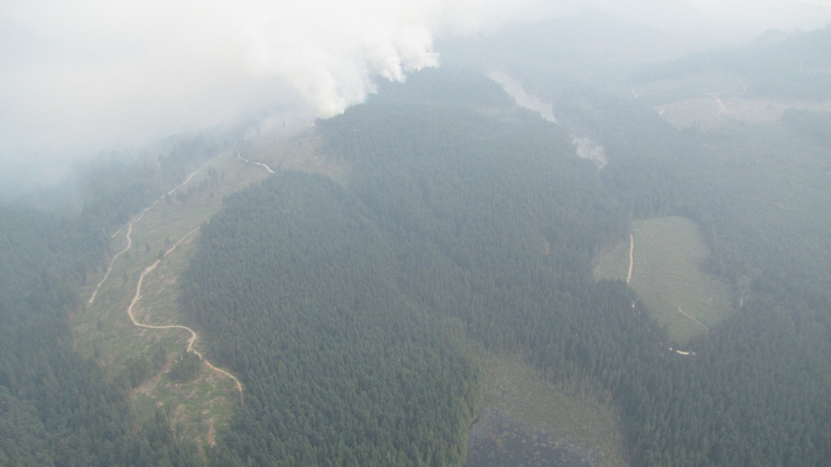
V50256 - July 7, 2016

Slide 12
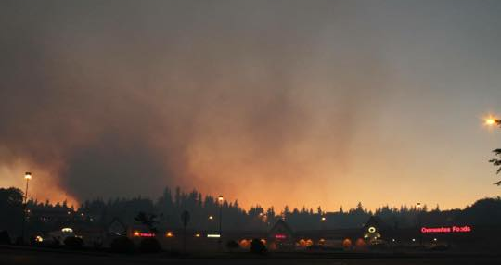
Large Coastal Fires
Tsulquate River, V90270
~ 1.5 km west of Port Hardy
Type | Full Response
Size | 17 ha | Cause | human
Start | July 3 | As at Nov: Patrol
Evacuation of subdivision Hydro project impacts Heavy slash, high winds Area restrictions

Slide 13
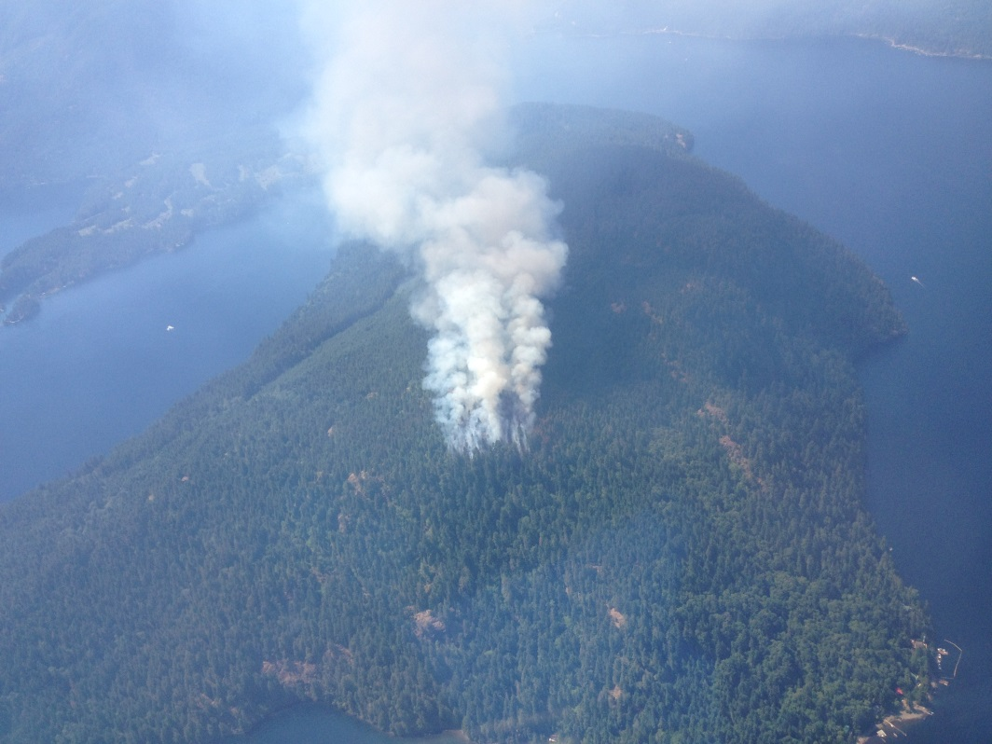
Large Coastal Fires
Dog Mountain, V70274
Dog Mnt on Sproat Lake
Type | Modified Response
Size | 450 ha | Cause | human
Start | July 4 | As at Nov: Patrol
One non-occupied vacation cabin burnt Evacuation alert for other cabins Controlled burn to remove excess ground fuels to contain fire to peninsula Periodic heavy smoke in valley

Slide 14
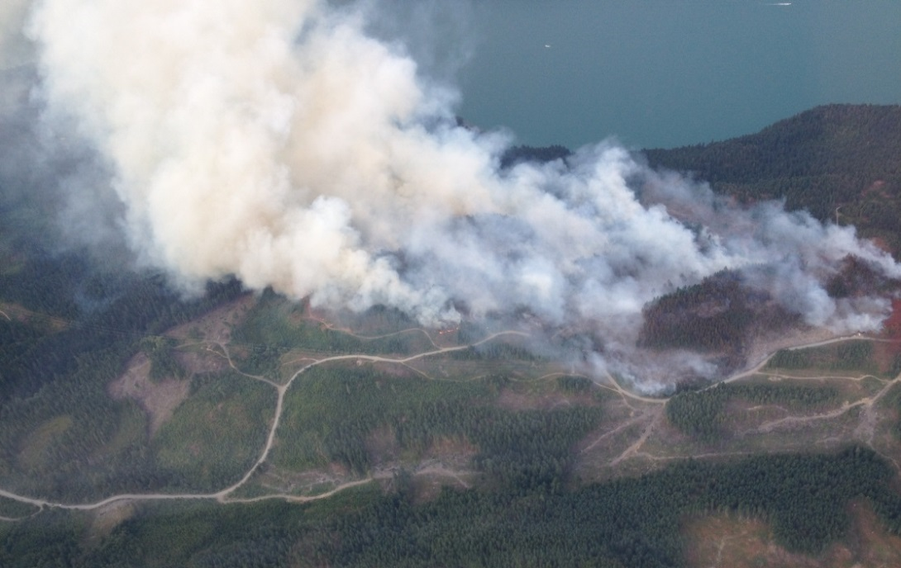
Large Coastal Fires
Wood Lake, V10370
Harrison Lake area
Type | Modified Response
Size | 1386 ha | Cause | human
Start | Aug 2 | As at Nov: Patrol
Popular recreational area Evacuated campers, area closures FS road closed periodically Steep terrain
Notes:
Impacts to FN and Hydro electric projects. Heavy slash loading.

Slide 15
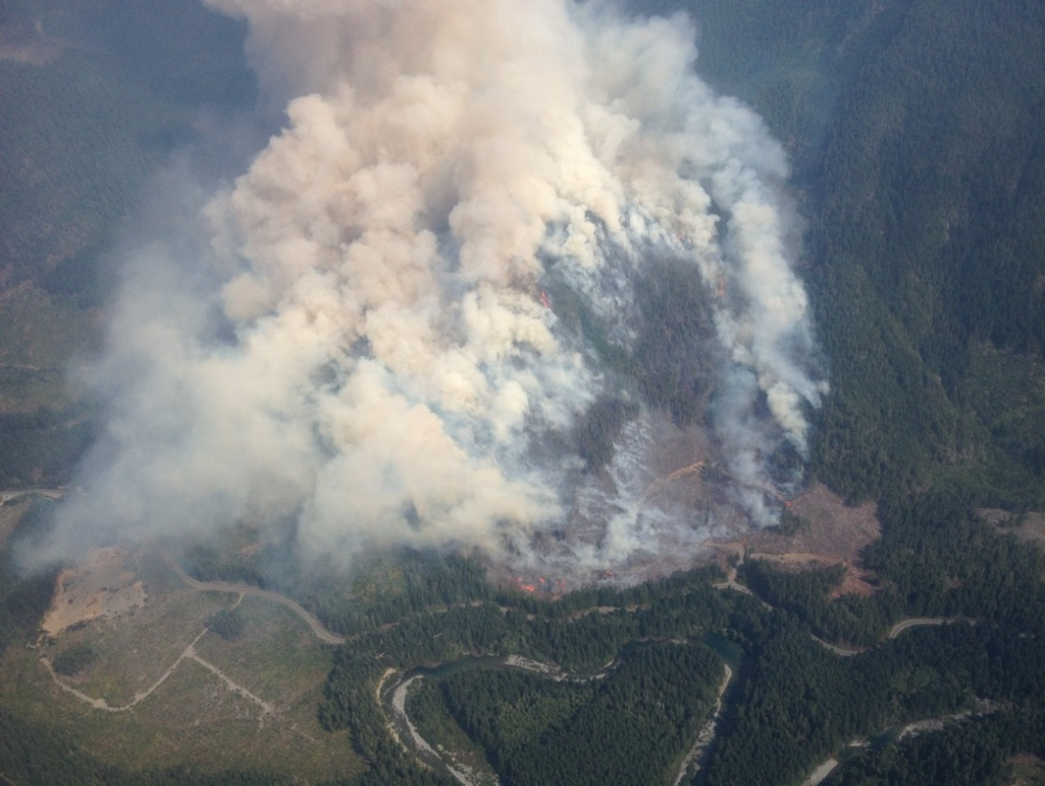
Large Coastal Fires
Spring Rd, 1 km from Lizard Lake, V60407
27 km south of Lake Cowichan, 11.5 km NE of Port Renfrew
Type | Modified Response
Size | 402 ha | Cause | human
Start | Aug 11 | As at Nov: Patrol
Closed Pacific Marine Circle highway Area closures Produced heavy smoke into Lake Cowichan and Duncan Very steep terrain, heavy slash

Slide 16
2015 Open Fire Prohibitions
Type | In | Rescind | Notes (Forest Districts)
Cat 2 | May 27 |  | Does not apply to Fog Zone or Haida Gwaii
Cat 3 | June 16 |  | All areas
Cat 2 | June 27 |  | Add Haida Gwaii + North Island/Central Coast
Campfire | June 27 |  | All areas except North Island/Central Coast, Haida Gwaii
Campfire | July 2 |  | Add North Island/Central Coast + Fog Zone
Campfire |  | July 14 | Remove Haida Gwaii + Fog Zone
Campfire |  | July 28 | Remove North Island/Central Coast
Campfire |  | Aug 12 | Remove Campbell River + all Strathcona Park
Campfire |  | Aug 28 | Allowed everywhere
Cat 2 + 3 |  | Sept 3 | Allowed everywhere except South Island
Cat 2 + 3 |  | Sept 14 | Allowed everywhere
Notes:
I have some slides that may display this information easier for you, let me know if you want them.

Slide 17
2015 Area Restrictions, road closures, evacuations
Fire | Order | Alert | Start | Stop | Comments
Cedar | X |  | July 2 | July 3 | 4 homes evacuated as a precaution - North Cowichan Regional District
Old Sechelt Mine |  | X | July 3 | July 6 | 18 Homes put on alert - Sunshine Coast Regional District
Tsulquate | X | X | July 4 | July 5 | 100 properties - District of Port Hardy - Mayors Way and Upper Carnarvon to Park Drive
Boulder Creek | X |  | July 4 | July 22 | Both sides of Upper Lillooet FSR, from 9 KM to the top of the Pemberton Valley, Electoral Area C
Dog Mountain | X |  | July 4 | July 6 | ~ 20 vacation cabins with boat access only. RCMP undertook Tactical Evac. No Evac order/alert put in by Alberni Clayoquot Regional District
Tsulquate |  | X | July 5 | July 10 | 100 properties - District of Port Hardy - Mayors Way and Upper Carnarvon to Park Drive
Dog Mountain | X |  | July 6 | July 7 | ~20 vacation cabins - Alberni Clayquot Regional District Eastern point of Dog Mtn located on Sproat Lake Lot #373.
Old Sechelt Mine | X |  | July 6 | July 12 | FSR closure resulted in loss of access to these cabins hence the Evacution Order.
Dog Mountain | X |  | July 7 | ongoing | Evacuation Order issued in consideration of the potential threat of slope instability as a result of the Dog Mountain wildfire.
Cougar Creek |  | X | July 10 | July 20 | Evacuation alert issued by the Fraser Valley Regional District for all properties along the Nahatlatch Forest Service Road, from the Nahatlatch River Rafting Resort Access Road (REO Whitewater Rafting) to the terminus of the Nahatlatch Forest Service Road
Old Sechelt Mine |  | X | July 12 | July 21 | 18 Homes put on alert by the Sunshine Coast Regional District
Old Sechelt Mine |  |  | July 21 | Removed | Alert removed , but Halfmoon Bay Carlson FSR remains closed to public.
Spring Rd/Lizard Lake |  |  | Aug 13 | Aug 28 | Pacific Marine Circle road closed (BC Highway)

Slide 18
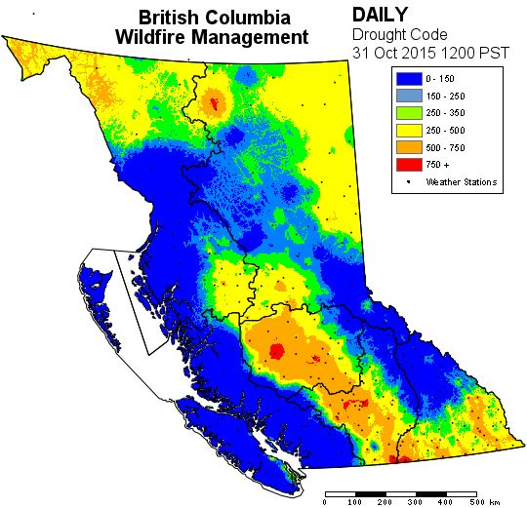
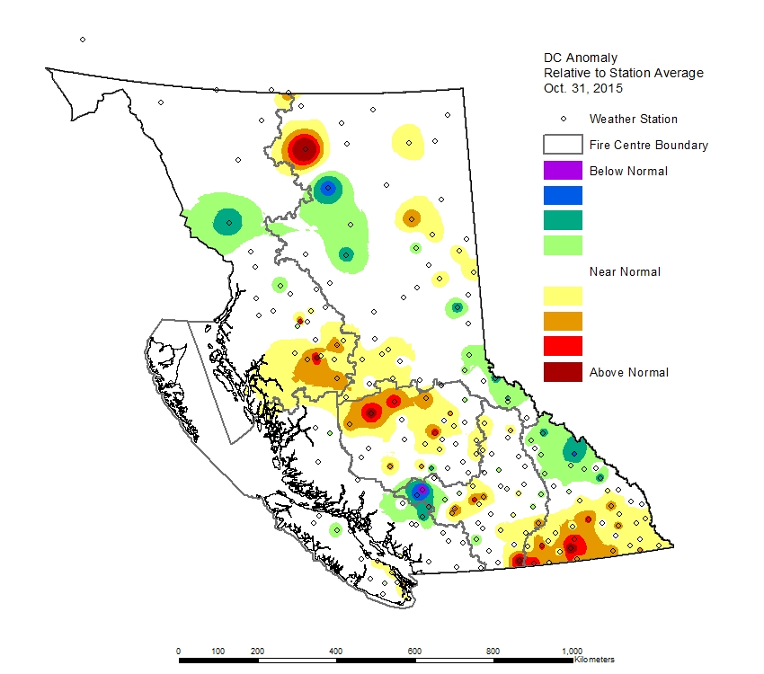
Oct 31, 2015 Drought Codes &
Drought Code Anomalies

Slide 19
2015 Prevention Stats.

Slide 20
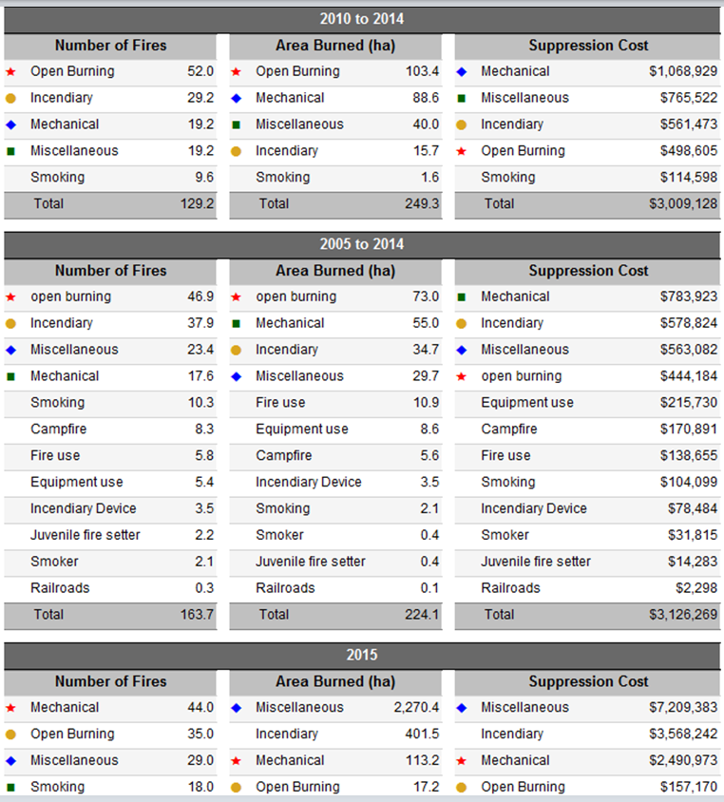
2015 Prevention Stats.

Slide 21
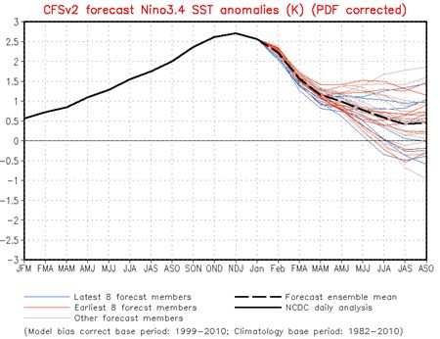
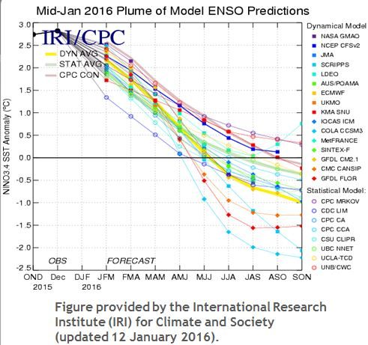
2016 Early Prediction
ENSO Forecast - the very strong El Nino continues but is weakening.
A transition to ENSO-neutral is likely during late spring or early summer of 2016, with a possible transition to La Niña conditions during the fall.
.

Slide 22
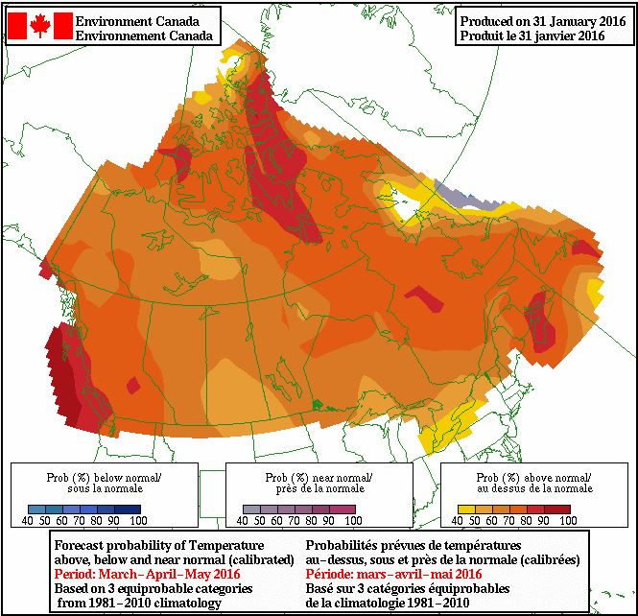
2016 Probability Maps: March – April - May
Temperature
Over the next two weeks the only temperature bias shown is for cooler than normal over much of the north. However the average probability over the next 3 months is for above seasonal temperatures across much of the province, especially along the coast.
Lack of forcing from an
El Nino or La Nina, increases the uncertainty of the long range models.

Slide 23
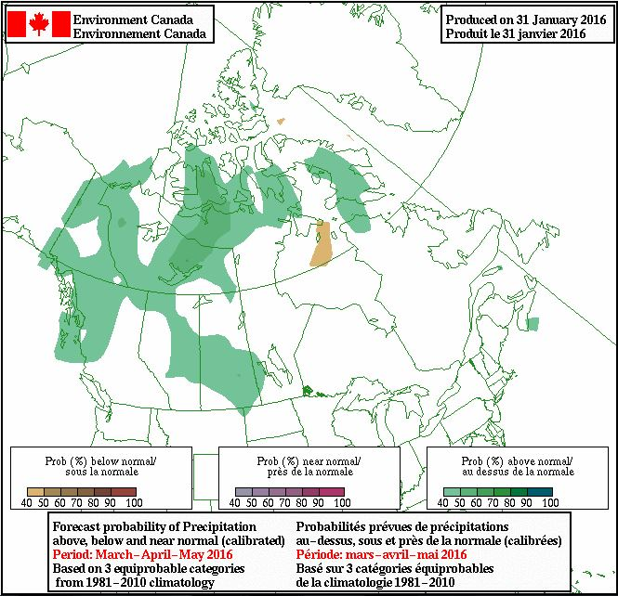
2016 Probability Maps: March – April - May
Precipitation
There is an equal chance of any of the 3 precipitation conditions occurring through the spring except for a slight bias for wetter than normal conditions in the NW and extreme NE.*
*The skill of long range precipitation forecasts is historically very low, especially in summer, when most precipitation is driven by local rather than larger scale conditions.

Slide 24
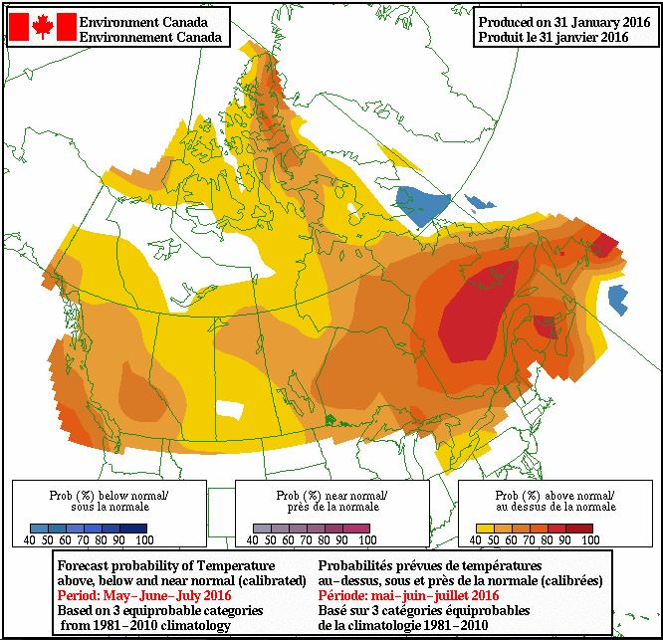
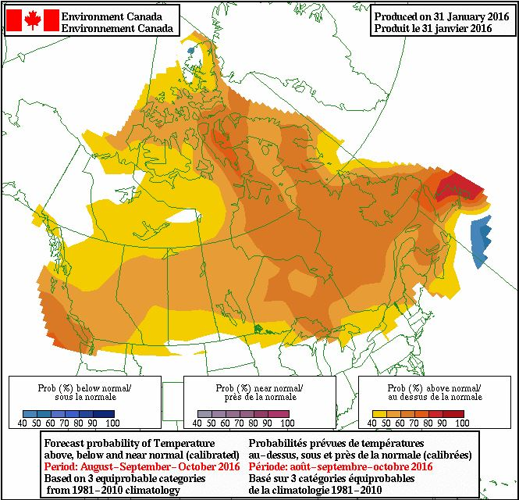
2016 Very Long Range Temperature Probability Maps
May, June, July
August, September, October
These very long range temperature projections suggest a reduced, but continued probability of higher than normal temperatures through the summer and into the fall.

Slide 25
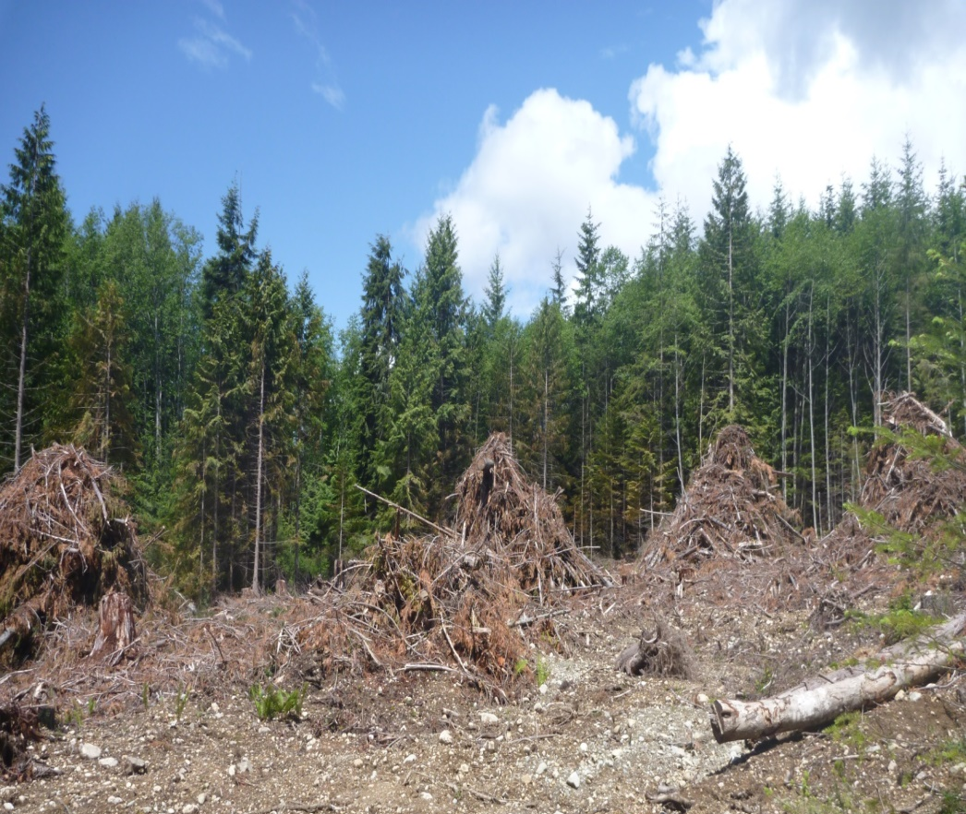
2016 - Other
Reduce fuel loading; ensure appropriate fuel hazard abatement
Inspections on high risk activity worksites during elevated fire danger (CEB)
Ensure reporting of all fires on industry chart (who, what, where, why & how & photo). Prevention Plan
Fire response claims. Ensure accurate documentation for resources on site
Notes:
Stress importance of early reporting, and IA
Stress importance of statutory obligations, i.e. fire caused by industrial activity, response is at the companies cost
Increased focus for province to complete FOC and recover costs from responsible parties
Currently the Levy may provide relief from suppression costs, however there is no relief from damages to crown assets or enforcement actions (i.e. Admin remedies)
Helicopter question always comes up. Airspace over the fire is restricted (5 nm, 3000agl), request/ notification of aircraft use must come to centre, aircraft company/pilot must be in FLNRO approved air carriers list, aircraft must monitor FLNRO frequencies 126.7 air to air, 3 hours total flight time approval. If aircraft is working the site or within 32 km (i.e. heli-logging) then it may be a statutory obligation (crownland).

